Slide 1
Day 1
Japan
2024 Summer Camp

Slide 2

Ice Breaker Questions
Everyone stand up in a line
I will ask a question
Would you rather drink coke or pepsi?
If you would rather drink coke, move to the left
If you would rather drink pepsi, move to the right

Slide 3


Ice Breaker Questions
Do you like summer or winter?
Summer
Winter

Slide 4

Ice Breaker Questions
Can you whistle?
Yes
No

Slide 5



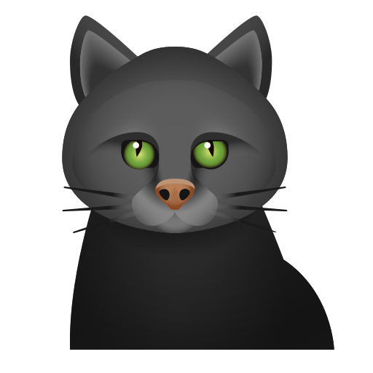


Ice Breaker Questions
Do you like cats or dogs?
cats
dogs

Slide 6

Ice Breaker Questions
Do you like mint chocolate?
Yes
No

Slide 7
Camp Rules
Be on time
Speak as much English as you can
Keep the classroom clean
Try your best

Slide 8
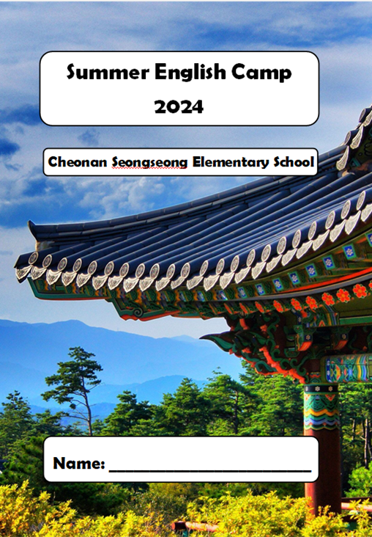
Camp Workbook

Slide 9
Japan
Day 1

Slide 10
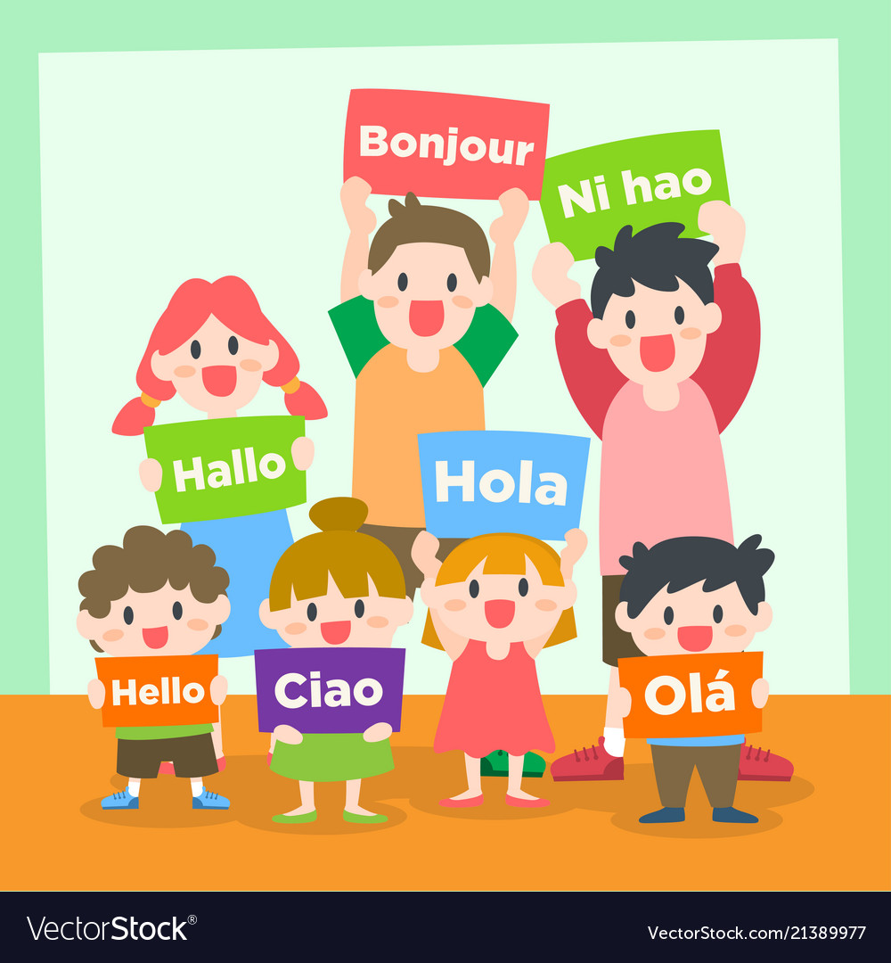

VOCABULARY WORDS
PG 3
수도 언어
capital city
ㅣlanguage

Slide 11

Let’s Learn About Japan
Japan
Japanese flag name ___________
Draw the Japanese flag here
Nisshōki

Slide 12

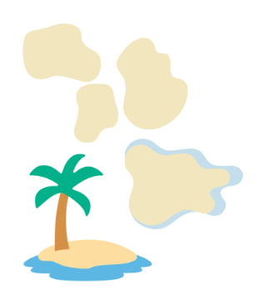
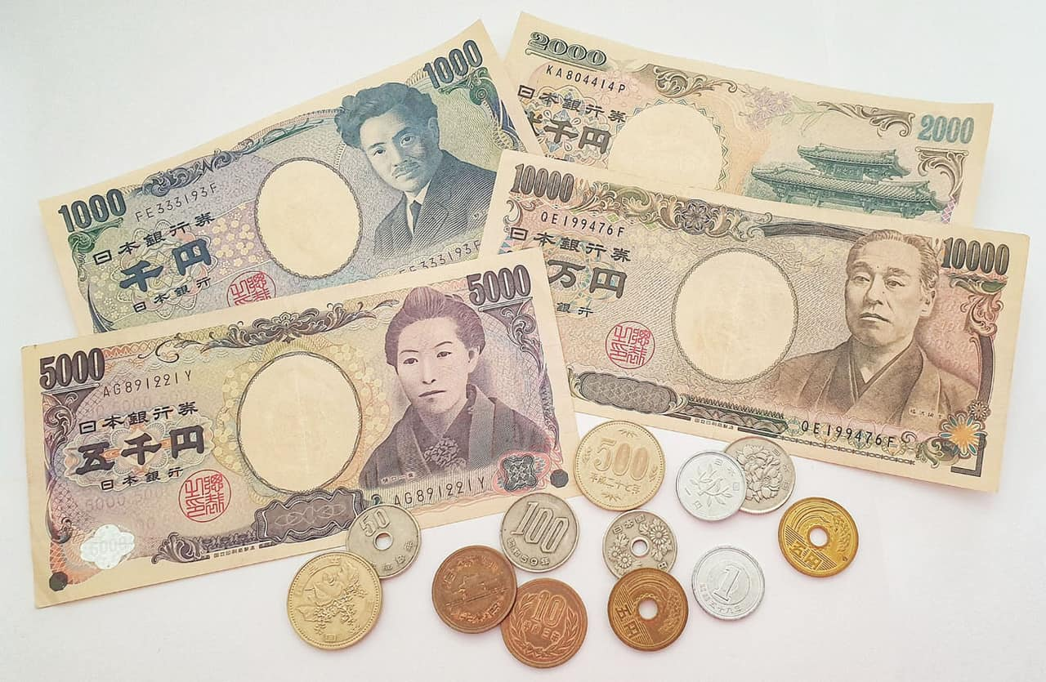
Let’s Learn About Japan
Capital city _______
Language _________
Tokyo
Japanese
Japanese Yen
nearly 7000
Japan has __________ islands.

Slide 13
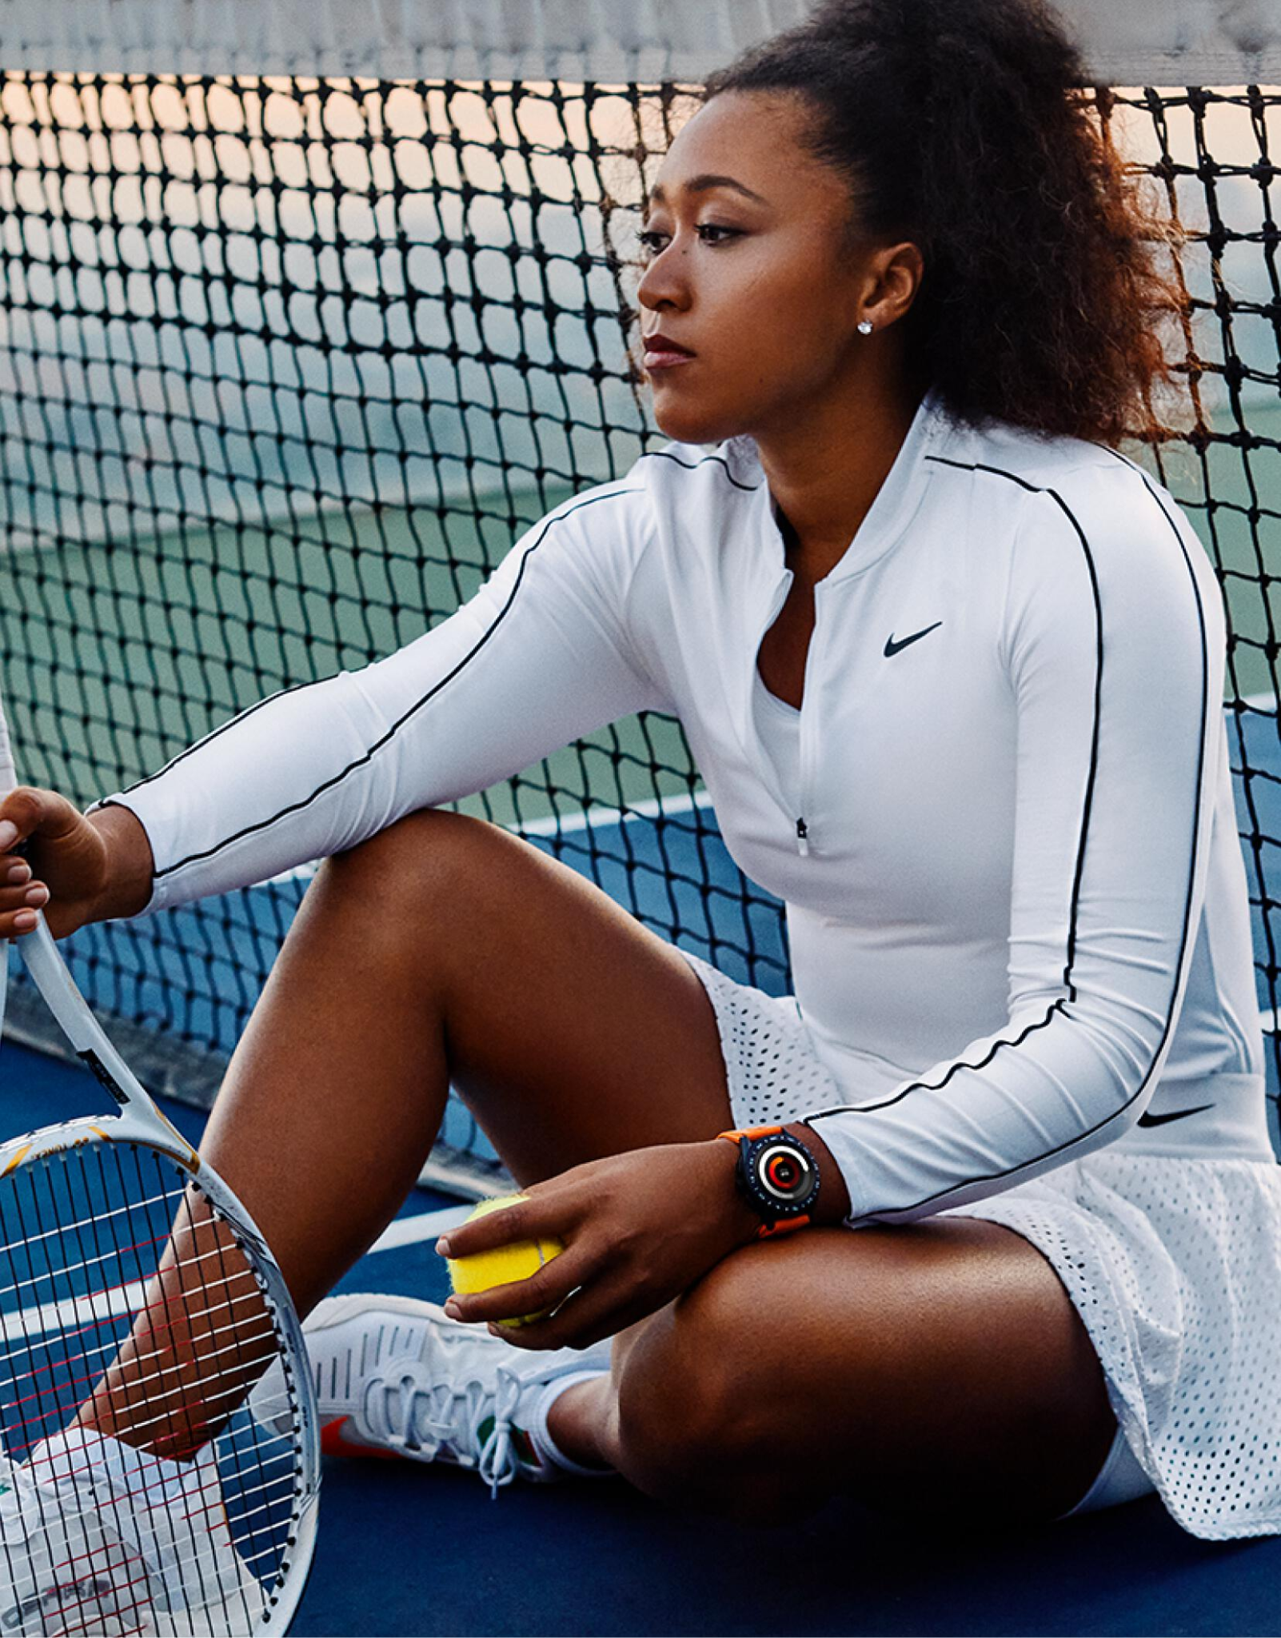
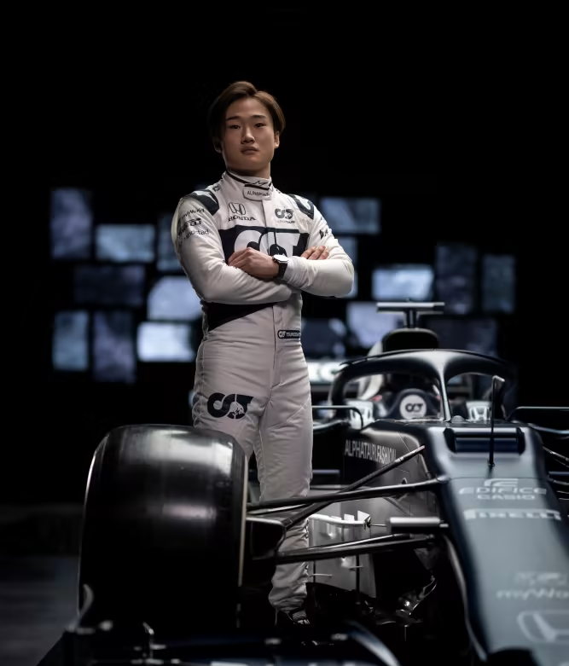
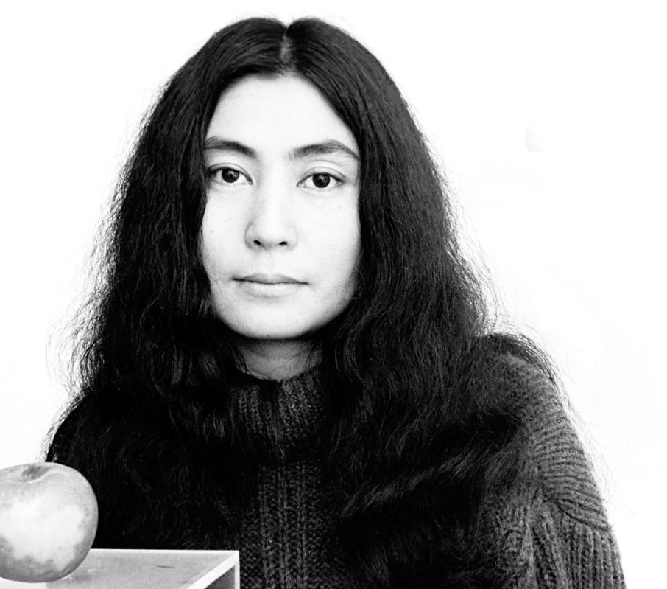
Famous People From Japan
I’m Naomi Osaka. I am a __________.
I’m Yoko Ono. I am an _______.
I’m Yuki Tsunoda. I am a __________ driver for Alpha Tauri.
Formula 1
tennis player
artist

Slide 14
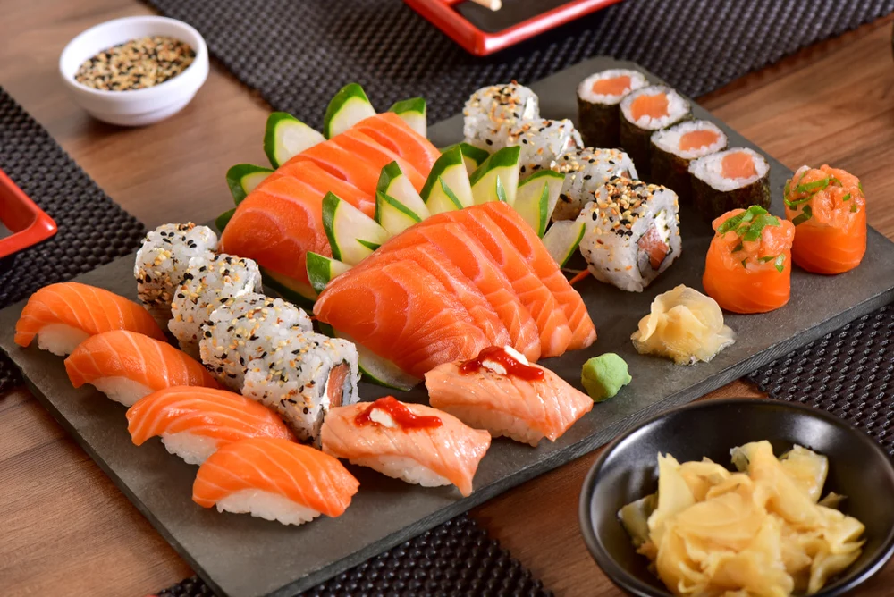
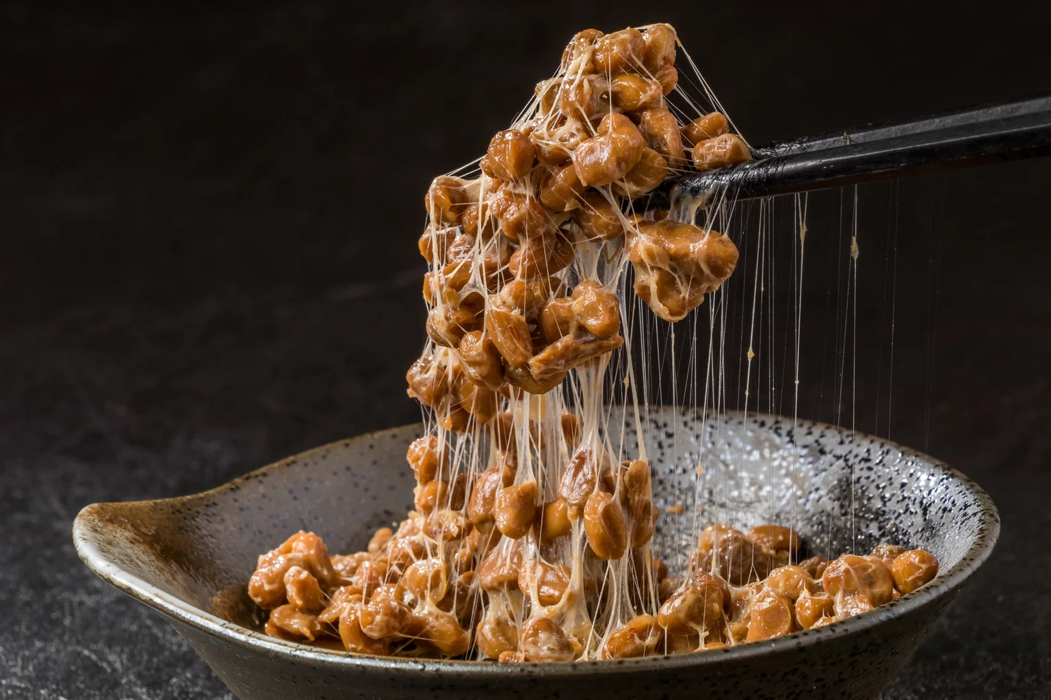
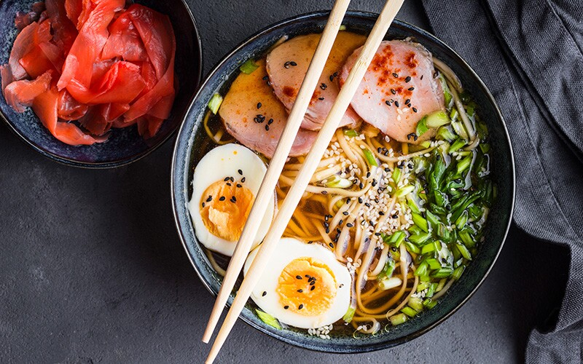
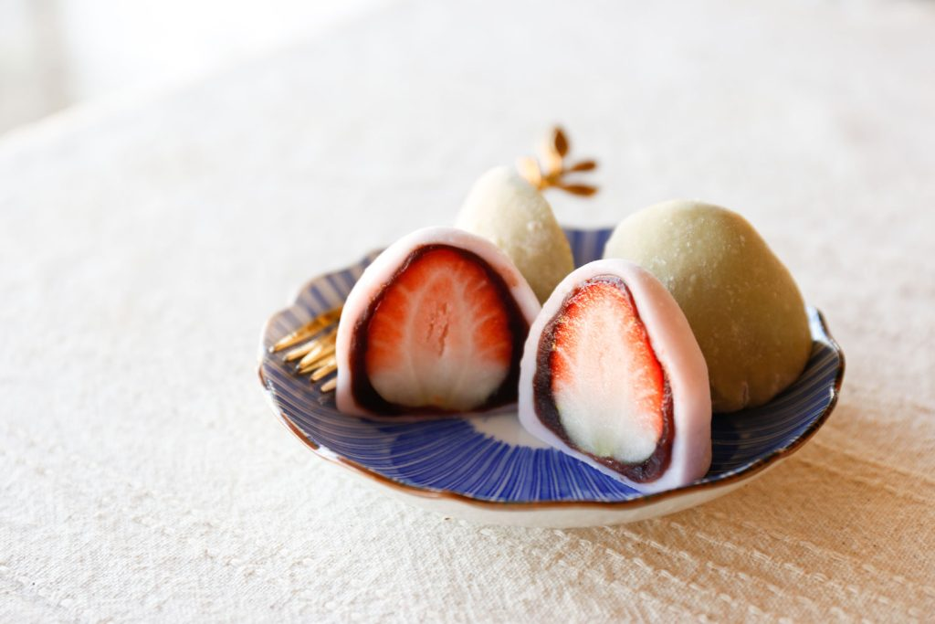
Japanese Food
Sushi
Nattō
Ramen
Mochi

Slide 15
Japanese Words
Arigatō
Ogenki desu ka?
thank you
English: ________
Korean: ________
English: __________
Korean: __________
how are you?
감사합니다
잘 지내세요?

Slide 16


FLIP CUP
Now we will play flip cup to practice what we learned about Japan.
Stand in a row behind your table
4
3
2
1

Slide 17

FLIP CUP
When I say GO, the first person picks up the cup, and reads the sentence
Blahh blahh blahh
1

Slide 18
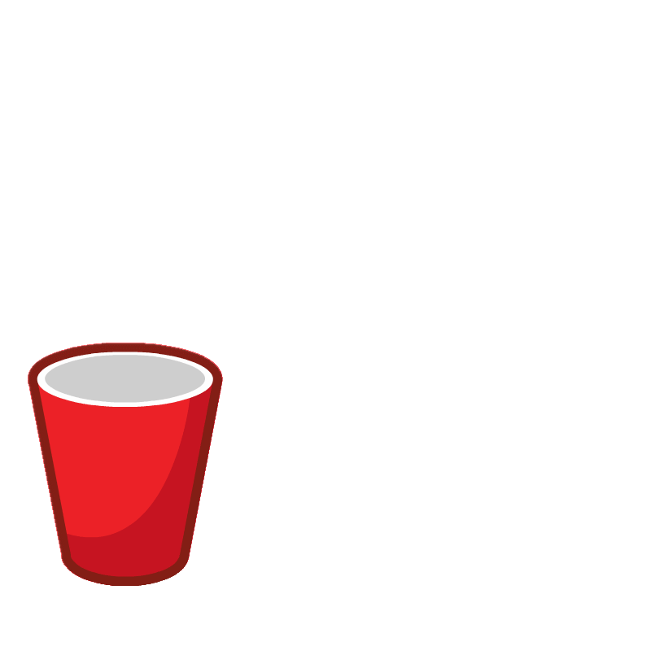
FLIP CUP
When you have finished reading the sentence, put your cup on the edge of the table
Flip it upside down

Slide 19
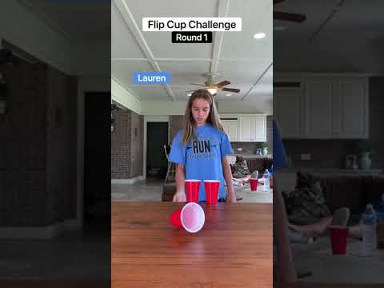
FLIP CUP

Slide 20
FLIP CUP
When you have flipped your cup, the next person reads the sentence.
First team to finish wins points
1
4
3
2
1

Slide 21
Ninja Star Target Practice
Team competition

Slide 22
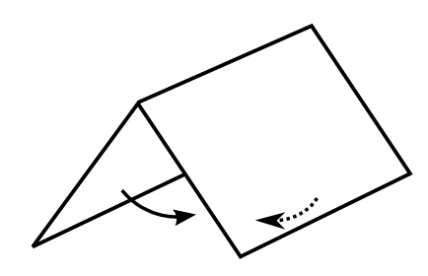


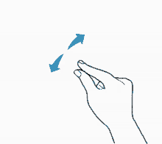
Some important origami words
Fold
Flip
Turn/Rotate
Pinch

Slide 23
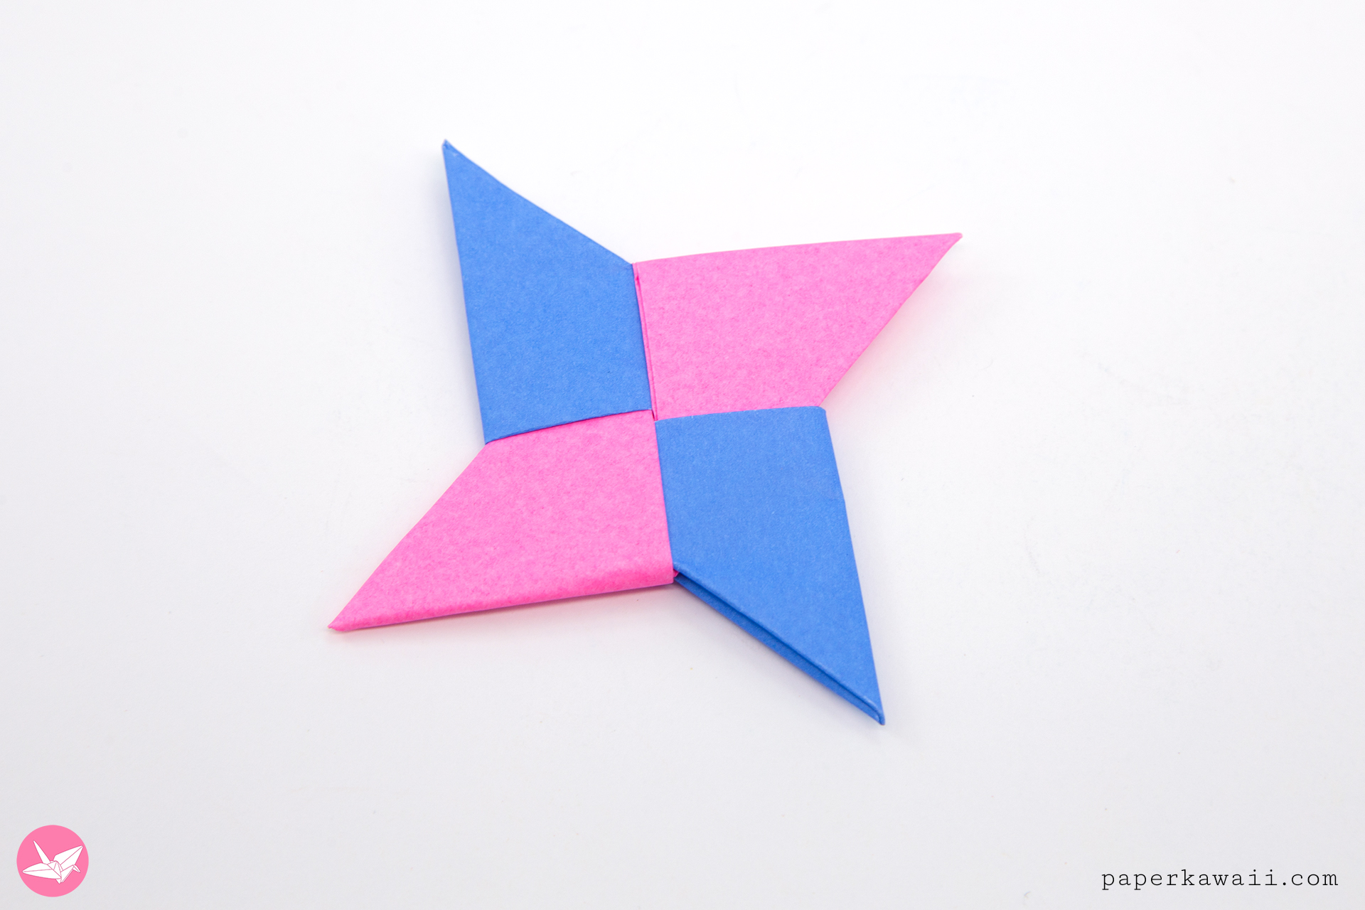
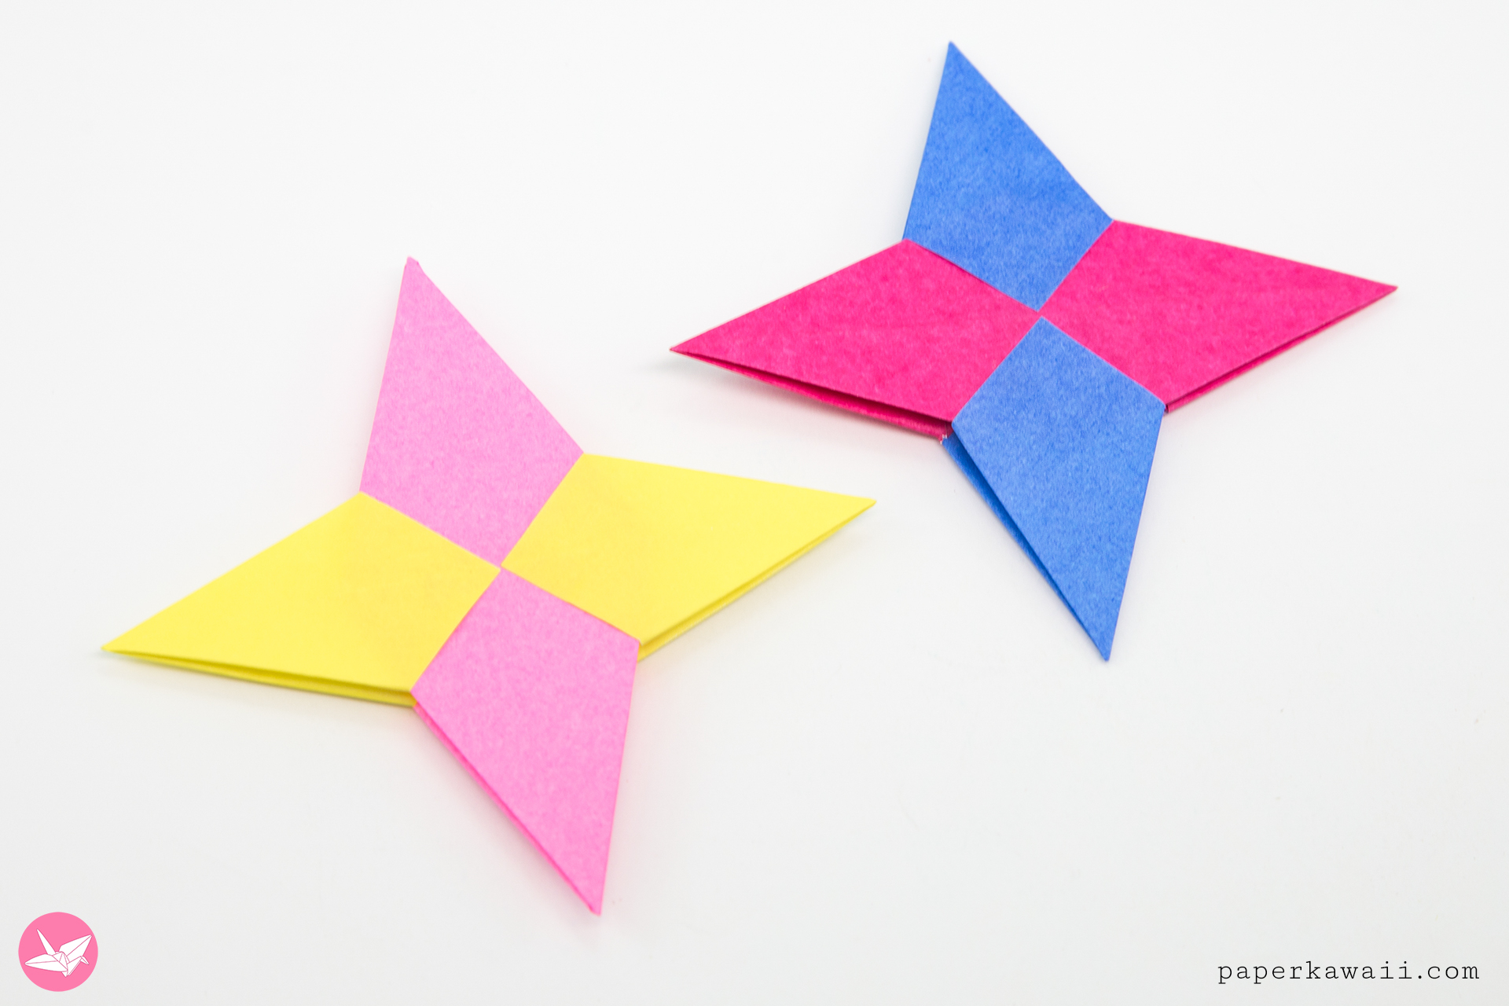
Ninja Stars

Slide 24
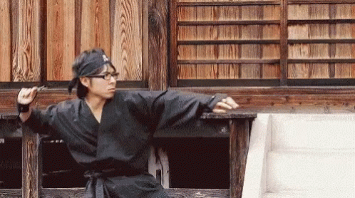
Target Practice
Practice throwing your ninja star for five minutes
You have four attempts to knock down the cup.
You will use your ninja star and your teammates ninja stars.

Slide 25
PassPort

Slide 26
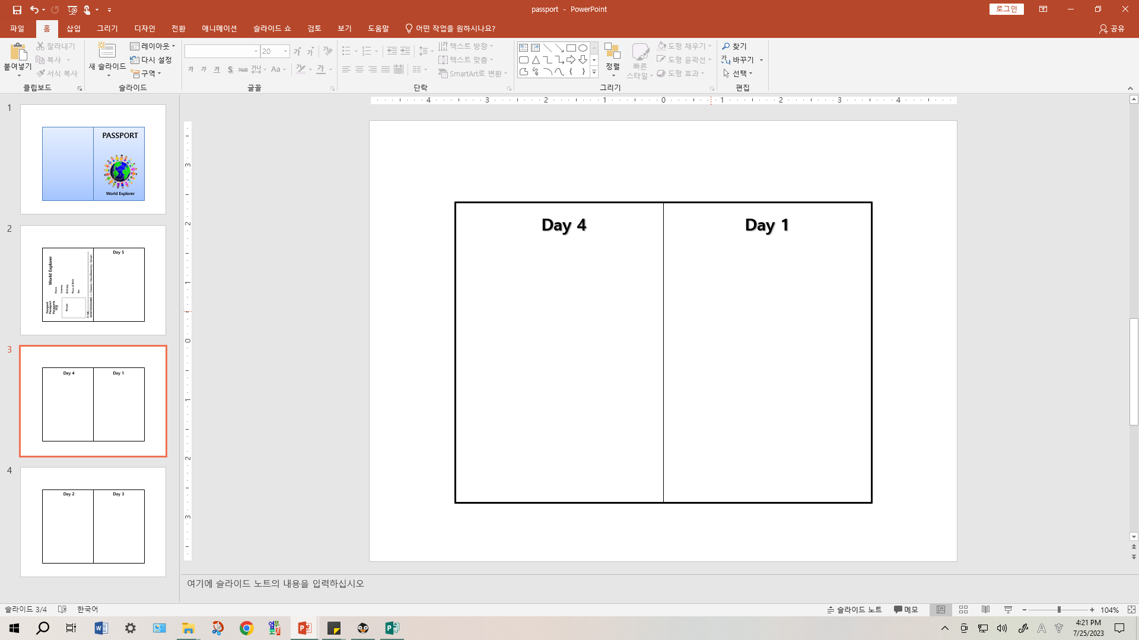
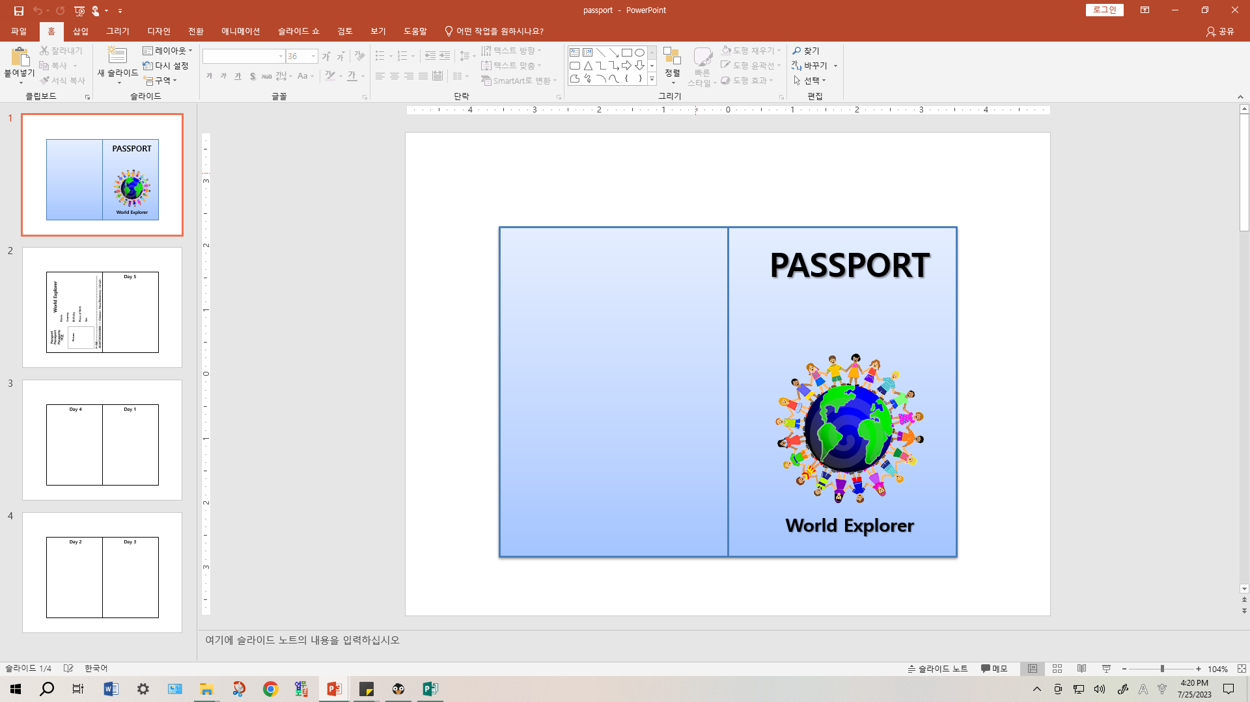
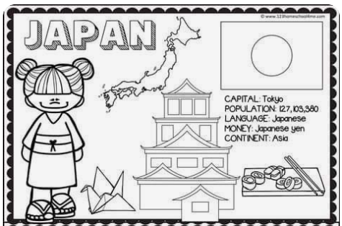

Slide 27
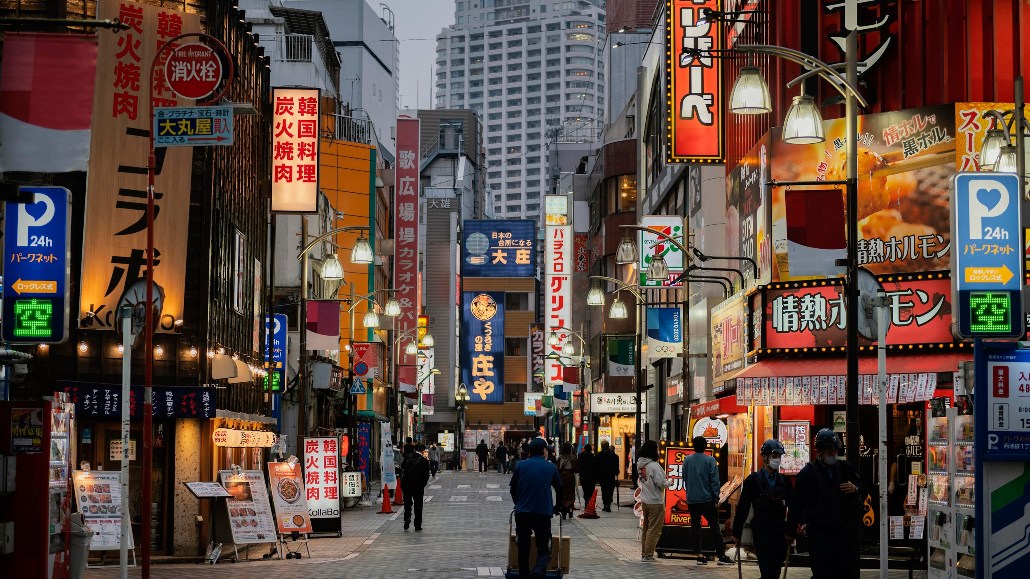
See you tomorrow! :)

